Slide 1

WEB TECHNOLOGIES
Document Object Model
Compiled by Kundhavai K R
Department of Computer Science and Engineering

Slide 2
The DOM
Document Object Model
JavaScript is always used to interact with the HTML document in which it is contained.
This is accomplished through a programming interface (API) called the Document Object Model.
According to the W3C, the DOM is a:
Platform- and language-neutral interface that will allow programs and scripts to dynamically access and update the content, structure and style of documents.

Slide 3
Introduction to DOM
With the object model, JavaScript gets all the power it needs to create dynamic HTML:
JavaScript can change all the HTML elements in the page
JavaScript can change all the HTML attributes in the page
JavaScript can change all the CSS styles in the page
JavaScript can remove existing HTML elements and attributes
JavaScript can add new HTML elements and attributes
JavaScript can react to all existing HTML events in the page
JavaScript can create new HTML events in the page

Slide 4
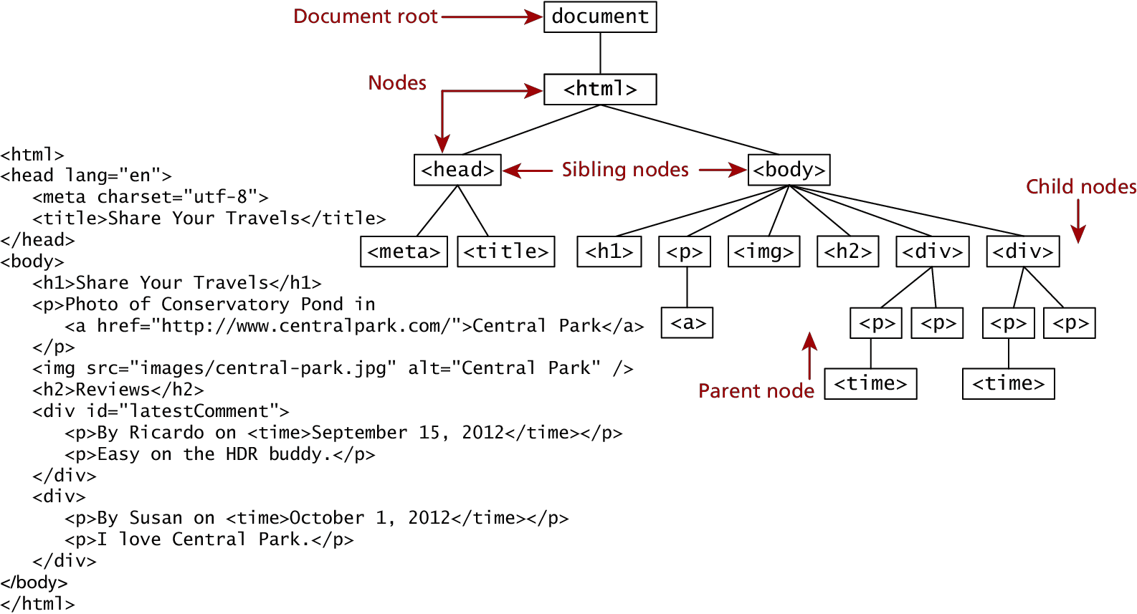
The DOM
Seems familiar, because it is!
DOM Tree , or topmost object called the Document Root.

Slide 5
DOM Nodes
In the DOM, each element within the HTML document is called a node. If the DOM is a tree, then each node is an individual branch.
There are:
element nodes,
text nodes, and
attribute nodes
All nodes in the DOM share a common set of properties and methods.

Slide 6
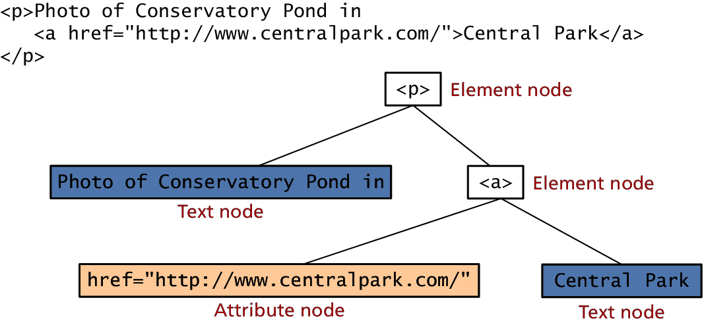
DOM Nodes
Element, text and attribute nodes

Slide 7
DOM Nodes
Essential Node Object properties

Slide 8
Document Object
One root to ground them all
The DOM document object is the root JavaScript object representing the entire HTML document.
It contains some properties and methods that we will use extensively in our development and is globally accessible as document.

Slide 9
Document Object
Document Object Methods
Notes:
getElementByClassName(name), removeChild(), appendChild(), replaceChild()

Slide 10
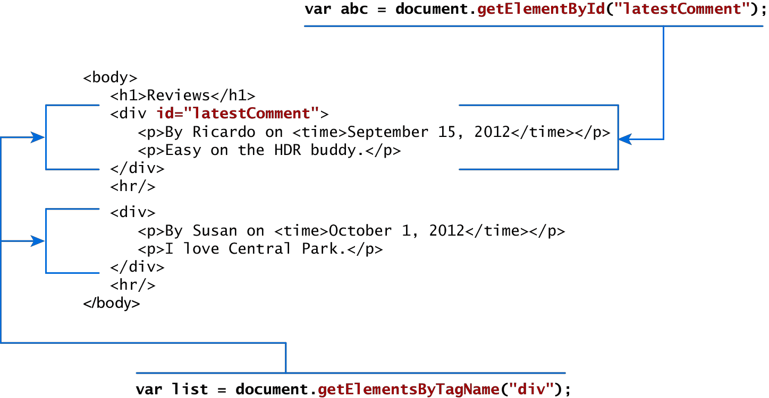
Accessing nodes
getElementById(), getElementsByTagName()

Slide 11
Modifying a DOM element Some node properties

Slide 12
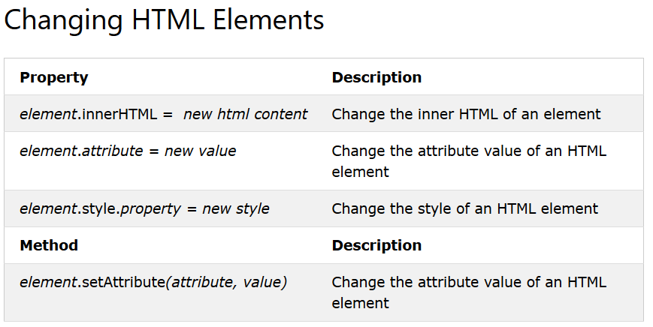

Slide 13
The setAttribute() method adds the specified attribute to an element, and gives it the specified value.
If the specified attribute already exists, only the value is set/changed.
Use the remove Attribute() method to remove an attribute from an element.

Slide 14
HTML DOM nodeType Property
The nodeType property returns the node type, as a number, of the specified node.
If the node is an element node, the nodeType property will return 1.
If the node is an attribute node, the nodeType property will return 2.
If the node is a text node, the nodeType property will return 3.
If the node is a comment node, the nodeType property will return 8.
This property is read-only.

Slide 15

DOM
Objects have properties and methods, and respond to events.
Properties – specify attributes or characteristic of object .
Methods – specify functions object can perform.
Events – methods corresponding to user actions.
These nodes can be elements, attributes, text content, comments.

Slide 16
Document Object Model
Accessing Elements in DOM
Access Element By | Equivalent Selector | Method
ID | #demo | getElementByID(“demo”)
Class | .demo | getElementsByClassName(“demo”)
Tag | <tag name> like p | getElementsByTagName(“p”)
Selector (single) | Any CSS Selector | querySelector(“selector”)
Selector (all) |  | querySelectorAll(“selector”)

Slide 17
getElementById()
The document.getElementById() method returns the element of specified id.
The parameter of getElementById can be any expression that evaluates to a string.
syntax-
document.getElementById(“#id");

Slide 18
getElementsByTagName ()
getElementsByTagName is used to access elements and attributes using tag name.
This method will return an array of all the items with the same tag name as a NodeList object.
syntax-
document.getElementsByTagName(tagname)

Slide 19
innerHTML ()
Each html element has an innerHTML property that can be used to change the content of the html element.
The innerHTML property is useful for getting or replacing the content of HTML elements.
Setting the innerHTML property to a value, will update the content of the html element.
We will use innerHTML in conjunction with document.getElementById() .

Slide 20
getElementsByName()
The getElementsByName() method returns a collection of all elements in the document with the specified name (the value of the name attribute), as a NodeList object.
Syntax-
document.getElementsByName(name);

Slide 21
Document.querySelector()
The Document method querySelector() returns the first Element within the document that matches the specified selector, or group of selectors.
If no matches are found, null is returned.
Syntax-
element = document.querySelector(selectors);

Slide 22
Document.querySelectorAll()
The Document method querySelectorAll() returns a static (not live) NodeList representing a list of the document's elements that match the specified group of selectors.
If no matches are found, null is returned.
Syntax-
elementList= parentNode.querySelectorAll(selectors);

Slide 23
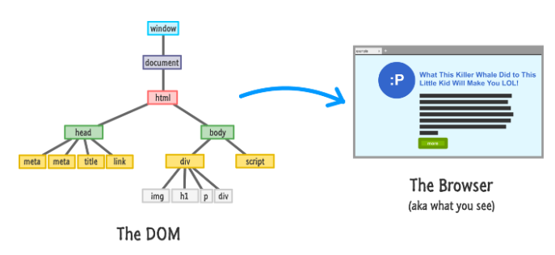
Traversing the DOM

Slide 24
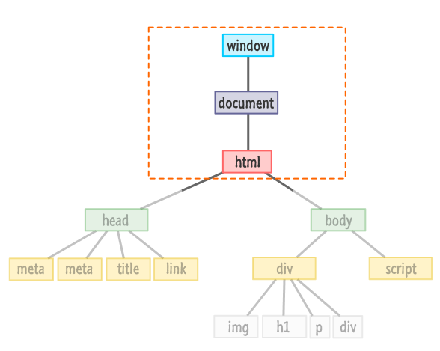
Traversing the DOM

Slide 25
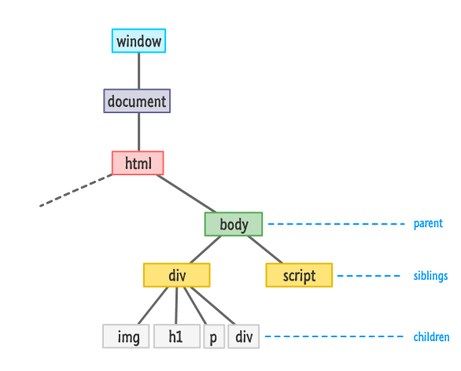
Traversing the DOM

Slide 26
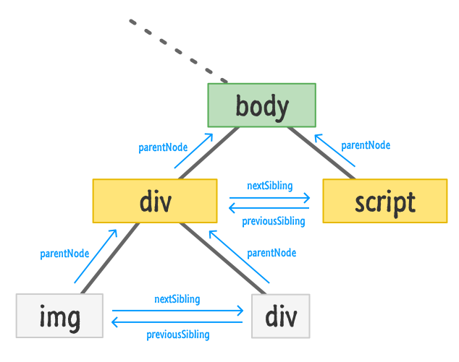
Document Object Model
Traversing the DOM

Slide 27
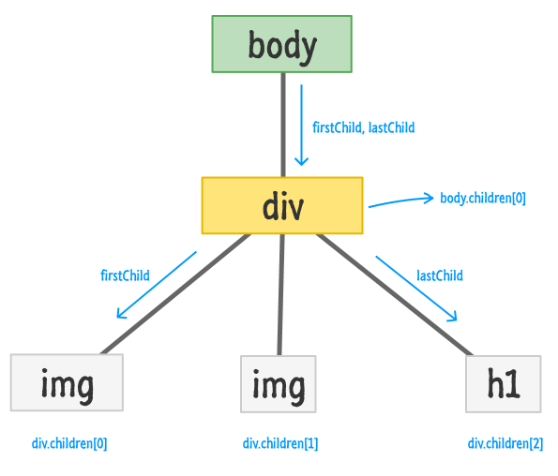
Document Object Model
Traversing the DOM

Slide 28
Document Object Model
Creating Element Objects
Method | Description
document.createElement() | Create a new element node using tag
document.createTextNode() | Create a new text node
Property | Description
node.textContent or node.innerText | Get or set the text content of an element node (without HTML tags)
node.innerHTML | Get or set the HTML content enclosed in the element tag

Slide 29
Document Object Model
Manipulating Nodes in the DOM
Method | Description
node.appendChild() | Add a node as the last child of the parent element.
node.insertBefore() | Insert a node into the parentbefore a specific sibling node
node.replaceChild() | Replace an existing node with a new node
node.removeChild() | Removes child node
node.remove() | Removes a node
* node here can be document.body or any existing element in the DOM

Slide 30
THANK YOU
Kundhavai K R
Department of Computer Science and Engineering

